Slide 1

ANÁLISIS DE DATOS ESPACIALES
EDIER V. ARISTIZÁBAL G.
Ing. Geólogo (Universidad Nacional de Colombia)
Esp. en Gestión de Riesgos Geológicos (Universidad de Ginebra – Suiza)
MSc. en Geociencias (Universidad de Shimane – Japón)
PhD. en Ingeniería (Universidad Nacional de Colombia)
Universidad Nacional de Colombia
Facultad de Minas
Departamento de Geociencias

Slide 2
All models are wrong, but some are useful.
George Box

Slide 3
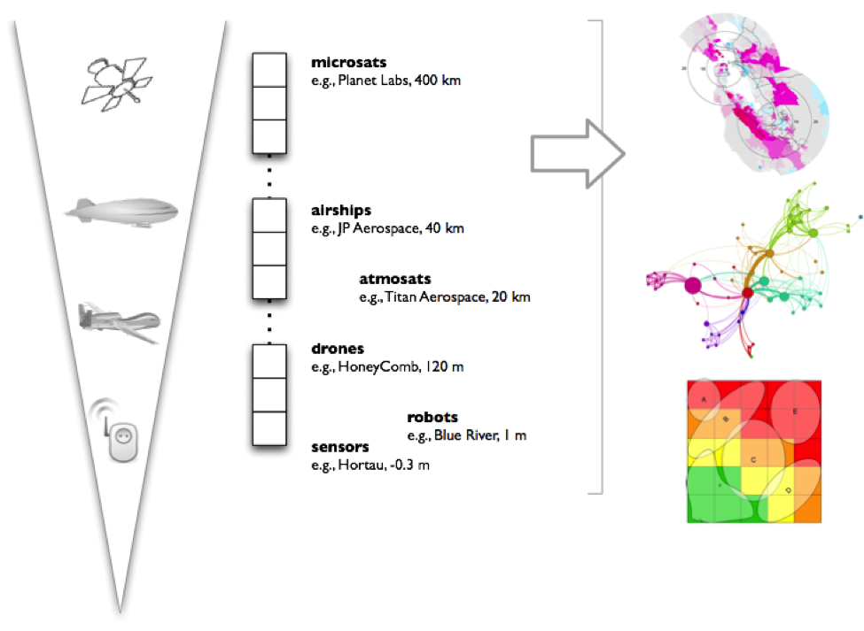
Geospatial data is data about objects, events, or phenomena that have a location on the surface of the earth, including location information (usually coordinates on the earth), attribute information (the characteristics of the object, event, or phenomena concerned), and often also temporal information (the time or life span at which the location and attributes exist).

Slide 4
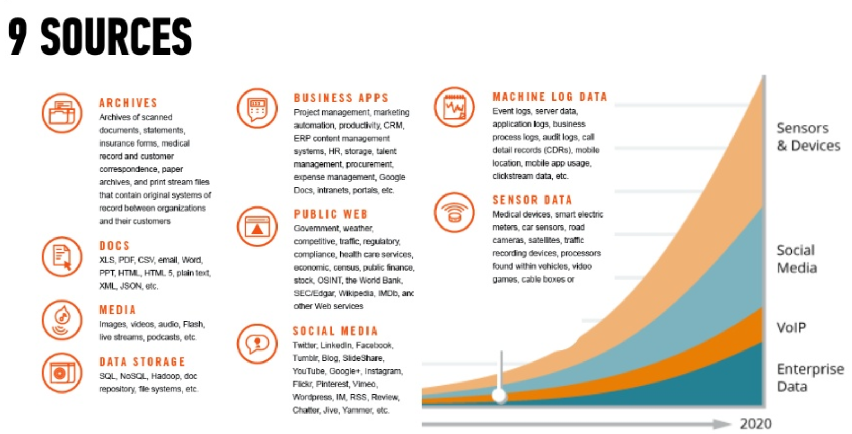

Slide 5
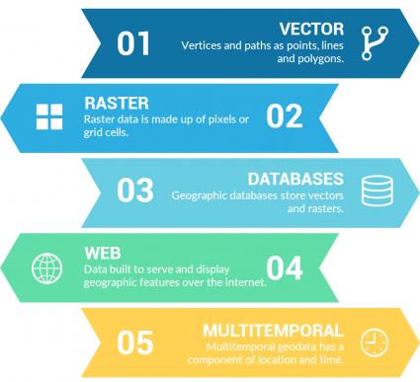

Slide 6
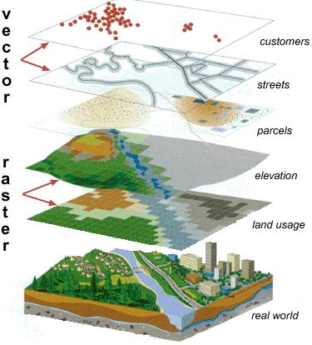

Slide 7
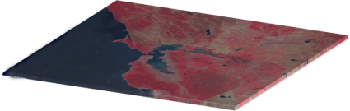
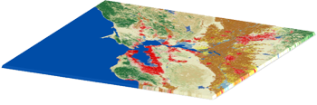
CONTINUOUS RASTERS have gradual change
Continuous rasters (non-discrete) are grid cells with gradual changing data such as elevation, temperature or an aerial photograph. A continuous raster surface can be derived from a fixed registration point. For example, digital elevation models use sea level as a registration point. Each cell represents a value above or below sea level.
DISCRETE RASTERS have distinct values
Discrete rasters have distinct themes or categories. For example, one grid cell represents a land cover class or a soil type.
In a discrete raster land cover/use map, you can distinguish each thematic class. Each class can be discretely defined where it begins and ends. In other words, each land cover cell is definable and it fills the entire area of the cell.
Discrete data usually consists of integers to represent classes.

Slide 8
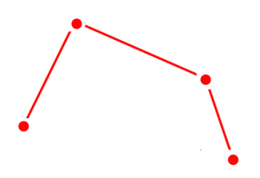
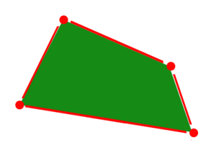
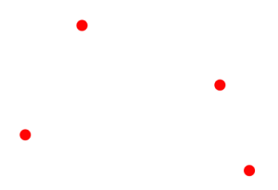
POINTS are XY coordinates
Vector points are simply XY coordinates. Generally, they are a latitude and longitude with a spatial reference frame. When features are too small to be represented as polygons, points are used. For example, you can’t see city boundary lines at a global scale.
LINES connect vertices
Vector lines connect each vertex with paths. Basically, you’re connecting the dots in a set order and it becomes a vector line with each dot representing a vertex.
Lines usually represent features that are linear in nature. For example, maps show rivers, roads and pipelines as vector lines.
POLYGONS connect vertices and closes the path
When you join a set of vertices in a particular order and close it, this is now a vector polygon feature. In order to create a polygon, the first and last coordinate pair are the same.
Cartographers use polygons to show boundaries and they all have an area. For example, a building footprint has a square footage and agricultural fields have acreage.

Slide 9
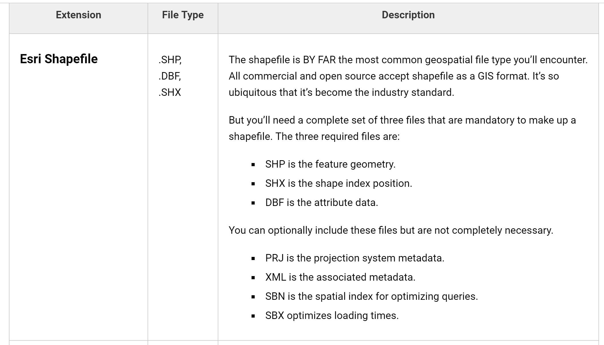
Vector GIS File Formats:
Vector graphics are comprised of vertices and paths.
The three basic symbol types for vector data are points, lines and polygons (areas). These GIS file formats house vector data.

Slide 10
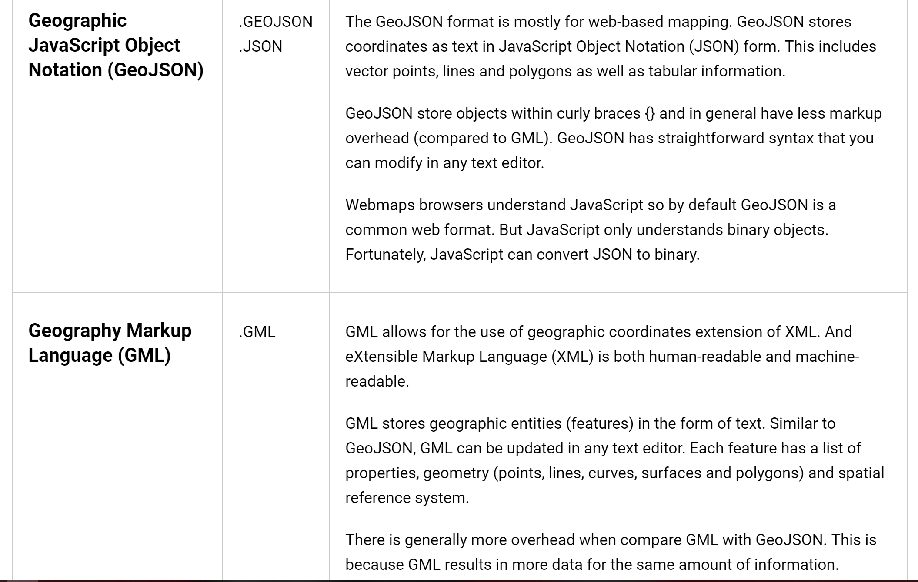
Vector GIS File Formats:

Slide 11
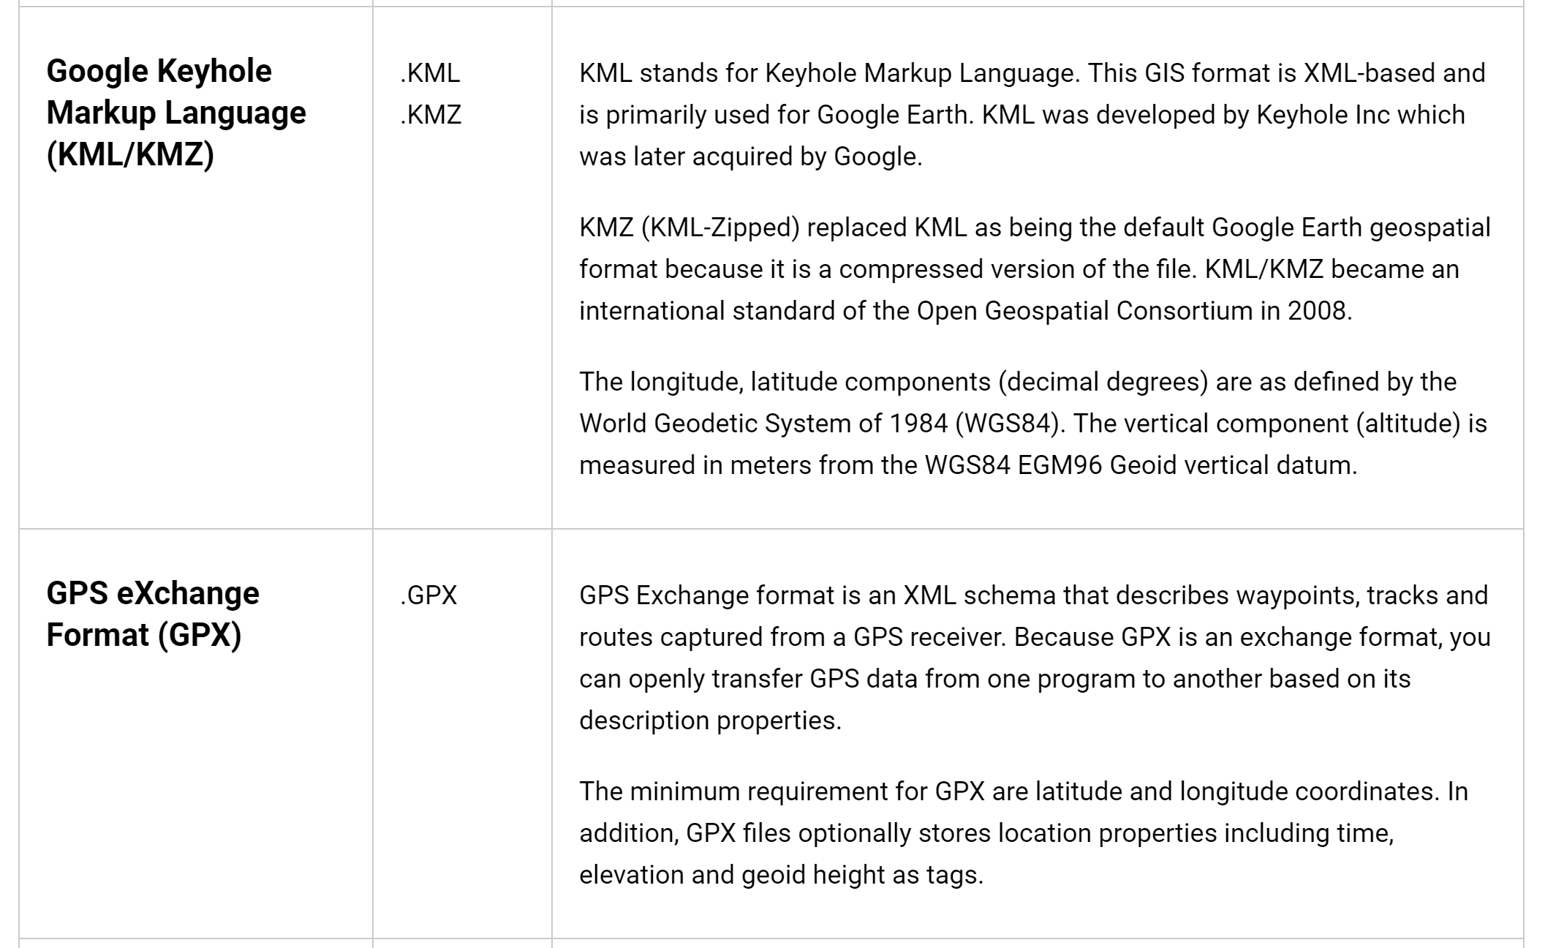
Vector GIS File Formats:

Slide 12
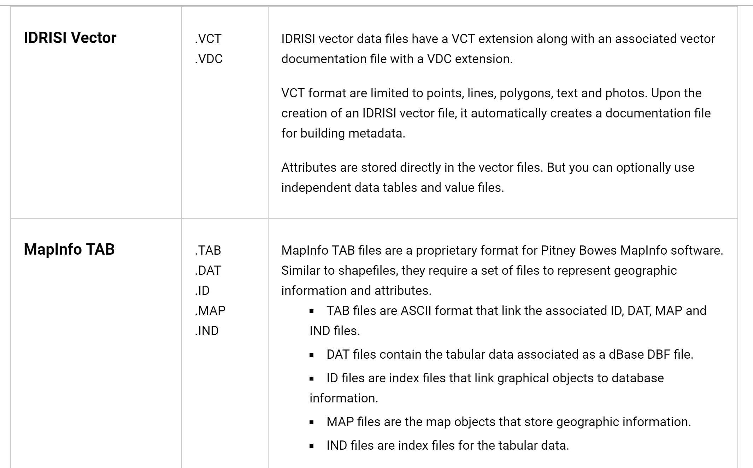
Vector GIS File Formats:

Slide 13
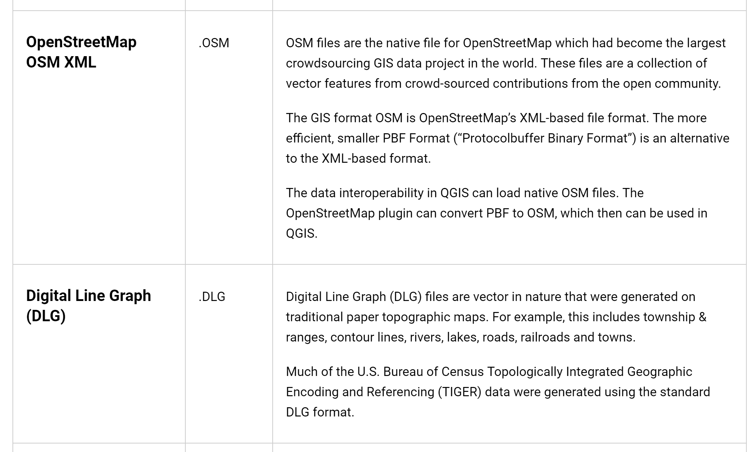
Vector GIS File Formats:

Slide 14
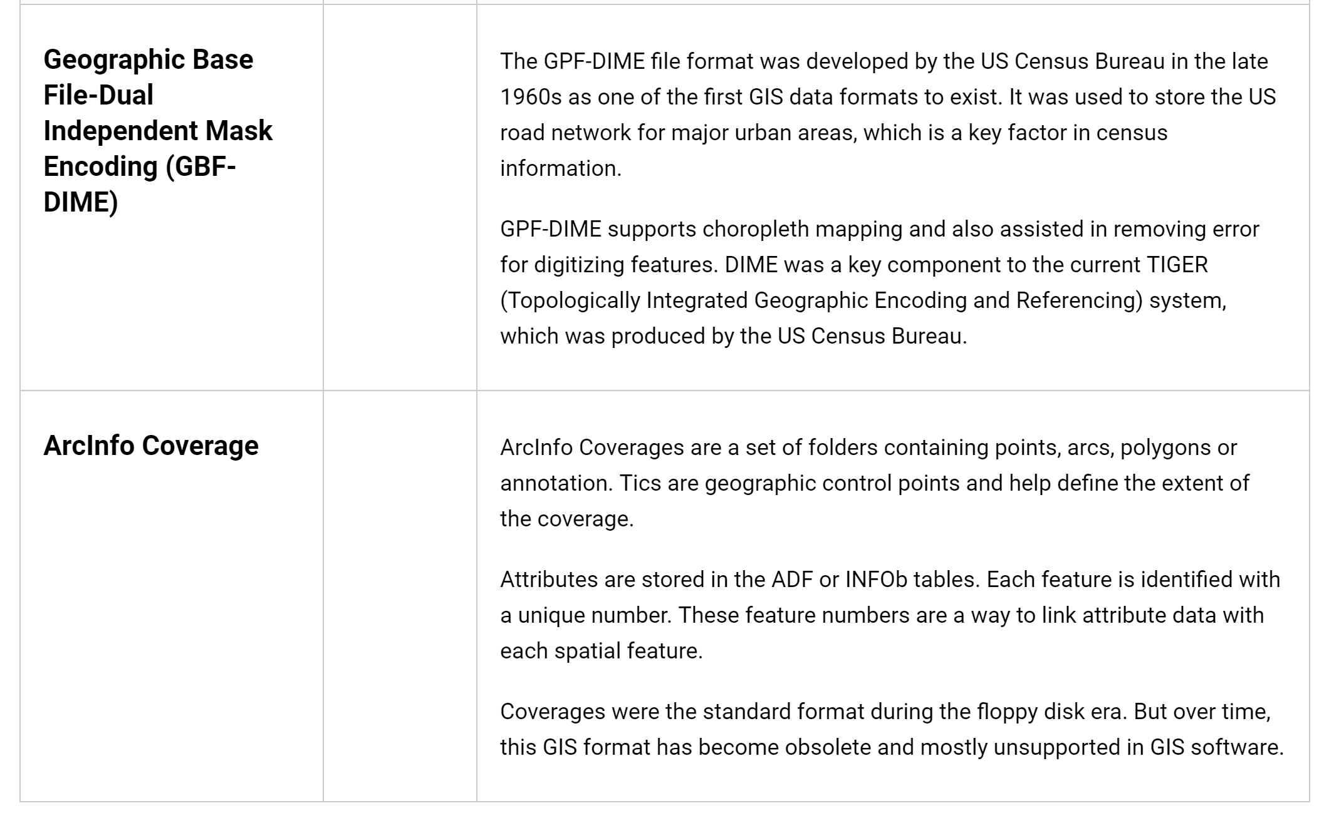
Vector GIS File Formats:

Slide 15
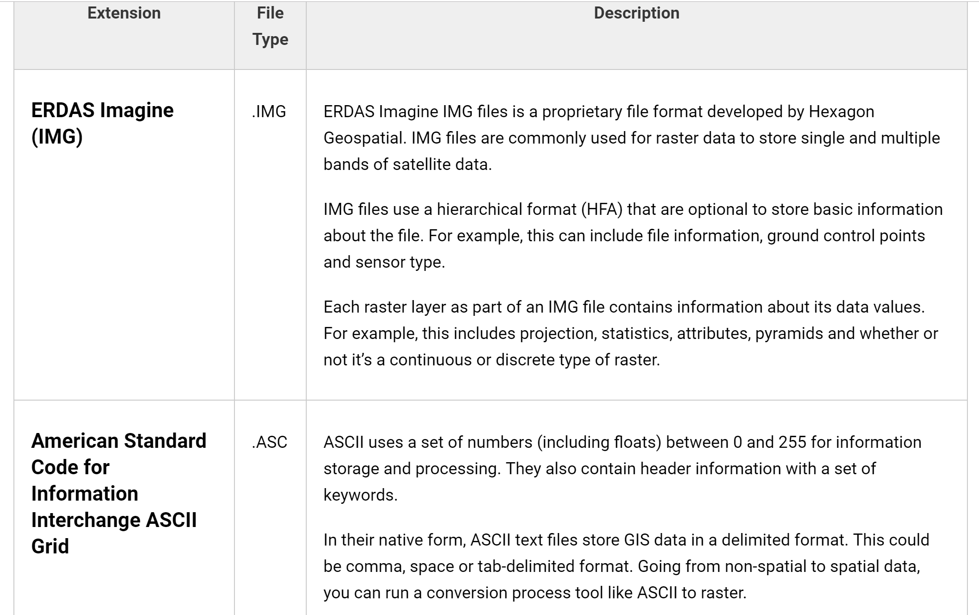
Raster GIS File Formats
Raster data is made up of pixels (also referred to as grid cells). They are usually regularly-spaced and square but they don’t have to be.
Rasters have pixel that are associated with a value (continuous) or class (discrete).

Slide 16
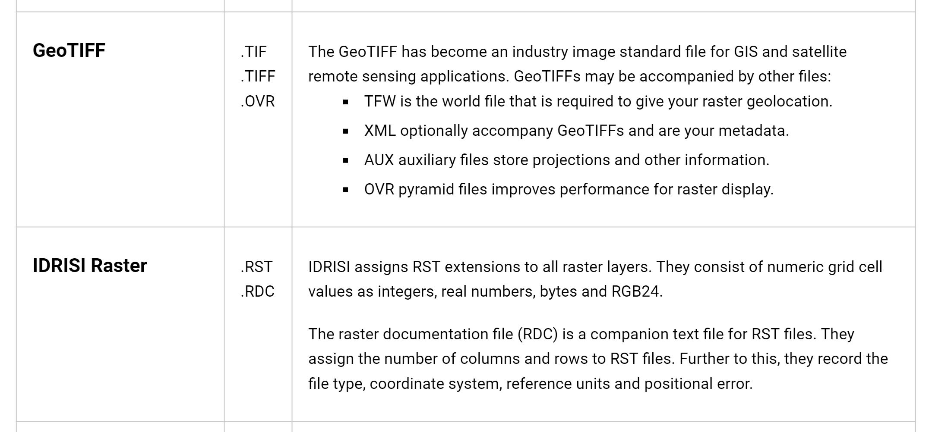
Raster GIS File Formats

Slide 17
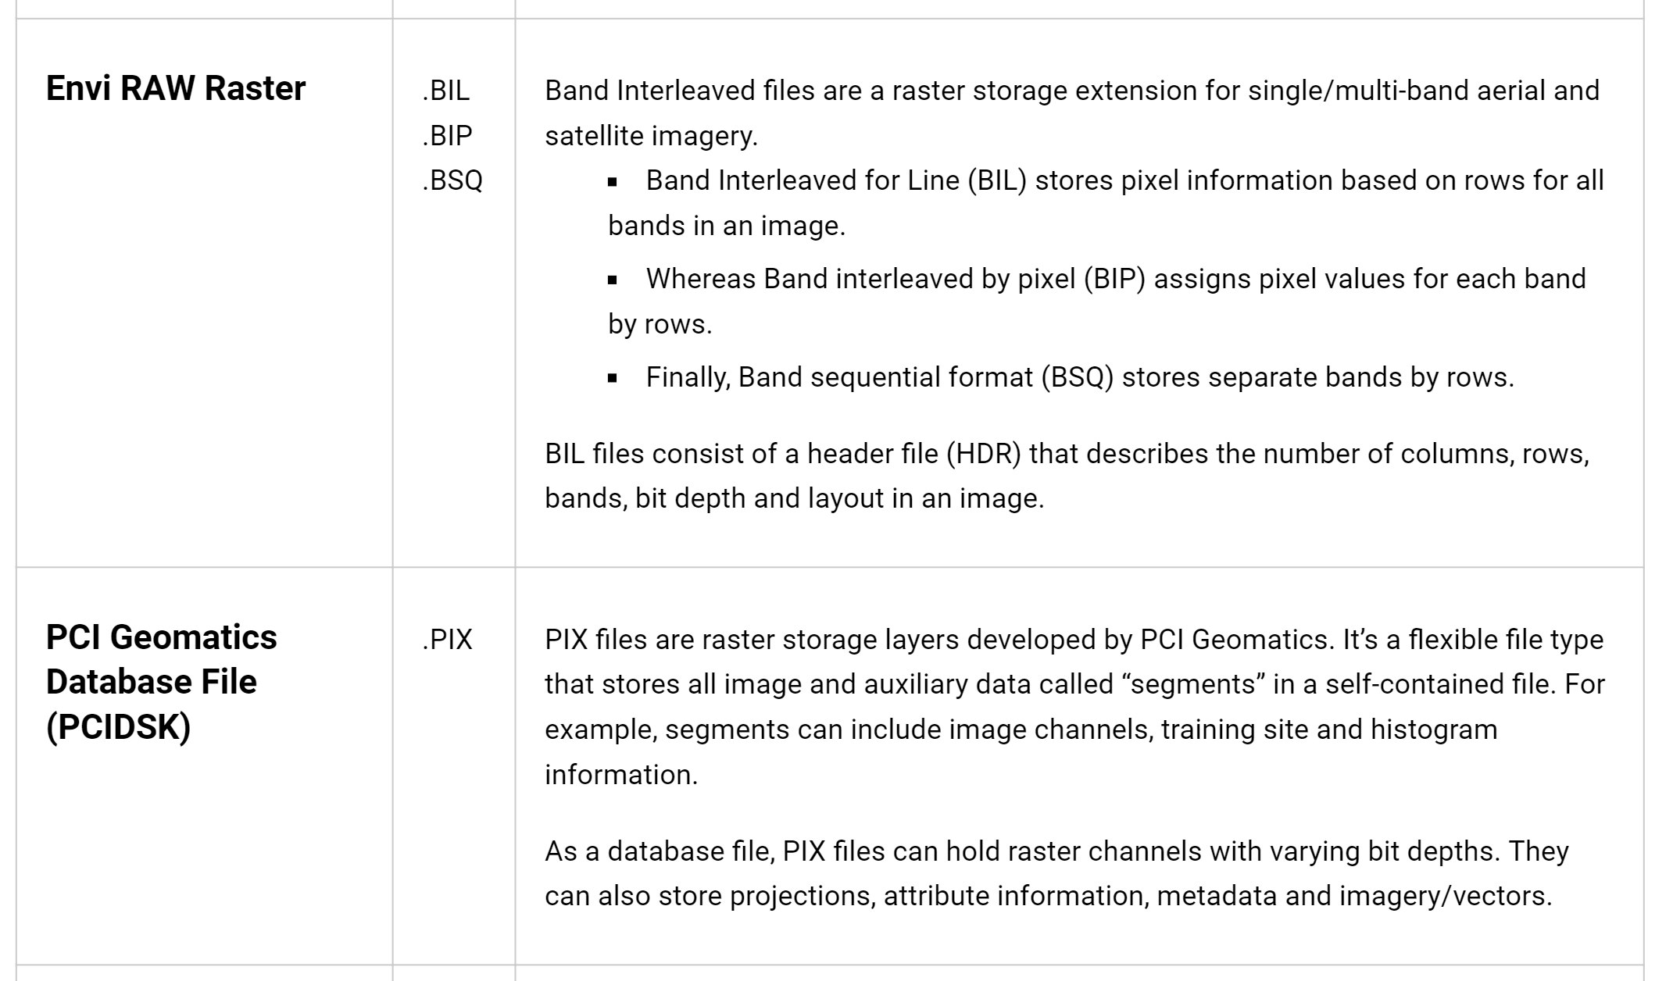
Raster GIS File Formats

Slide 18
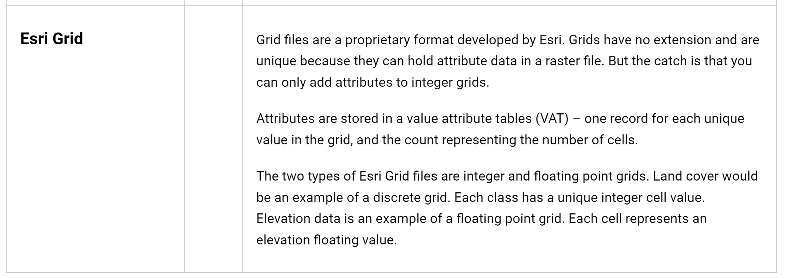

Slide 19
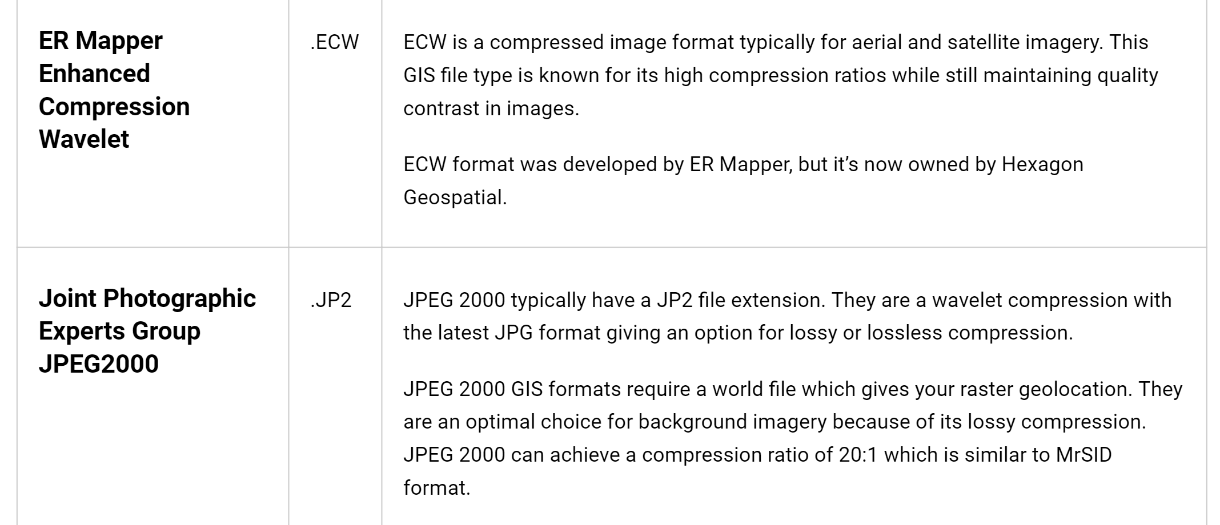
Compressed Raster File Formats
Lossy GIS compression reduces file size by permanently eliminating certain information, especially redundant information (even though the user may not notice it).
These lossy compression algorithms often result in greater reductions of file size. Here are examples of highly compressed GIS formats.

Slide 20
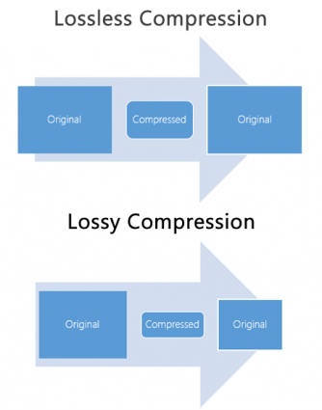
JPEG Compression Example
JPEG stands for Joint Photographic Experts Group, which is the group that created the standard. It has an extension of .JPG and .JPEG and is the most common image format used by digital cameras and on the World Wide Web.
It’s a lossy compression type for digital images. Lossy image compression reduces file size and eliminates redundant information. The user decides how much loss to introduce with a trade-off in storage size and quality.
For example, the compression quality is a range from 1 to 100. A lower value compresses the raster image, but also reduces the quality.
JPEG 2000 (JP2) is the newest version of JPEG. It slightly improves image compression performance over JPEG using two different wavelet transforms. Users can choose low to high levels of compression.

Slide 21
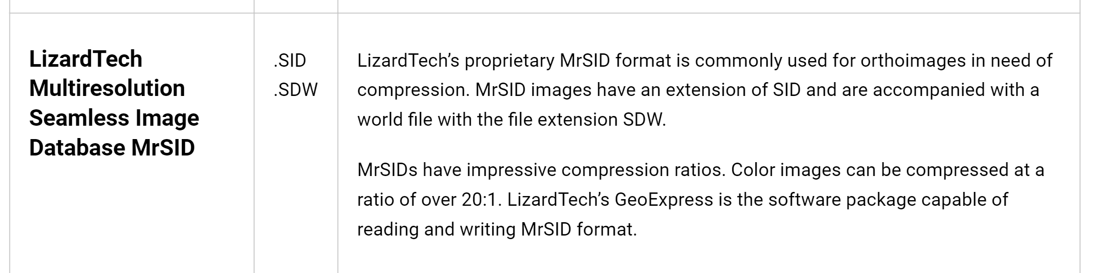

Slide 22
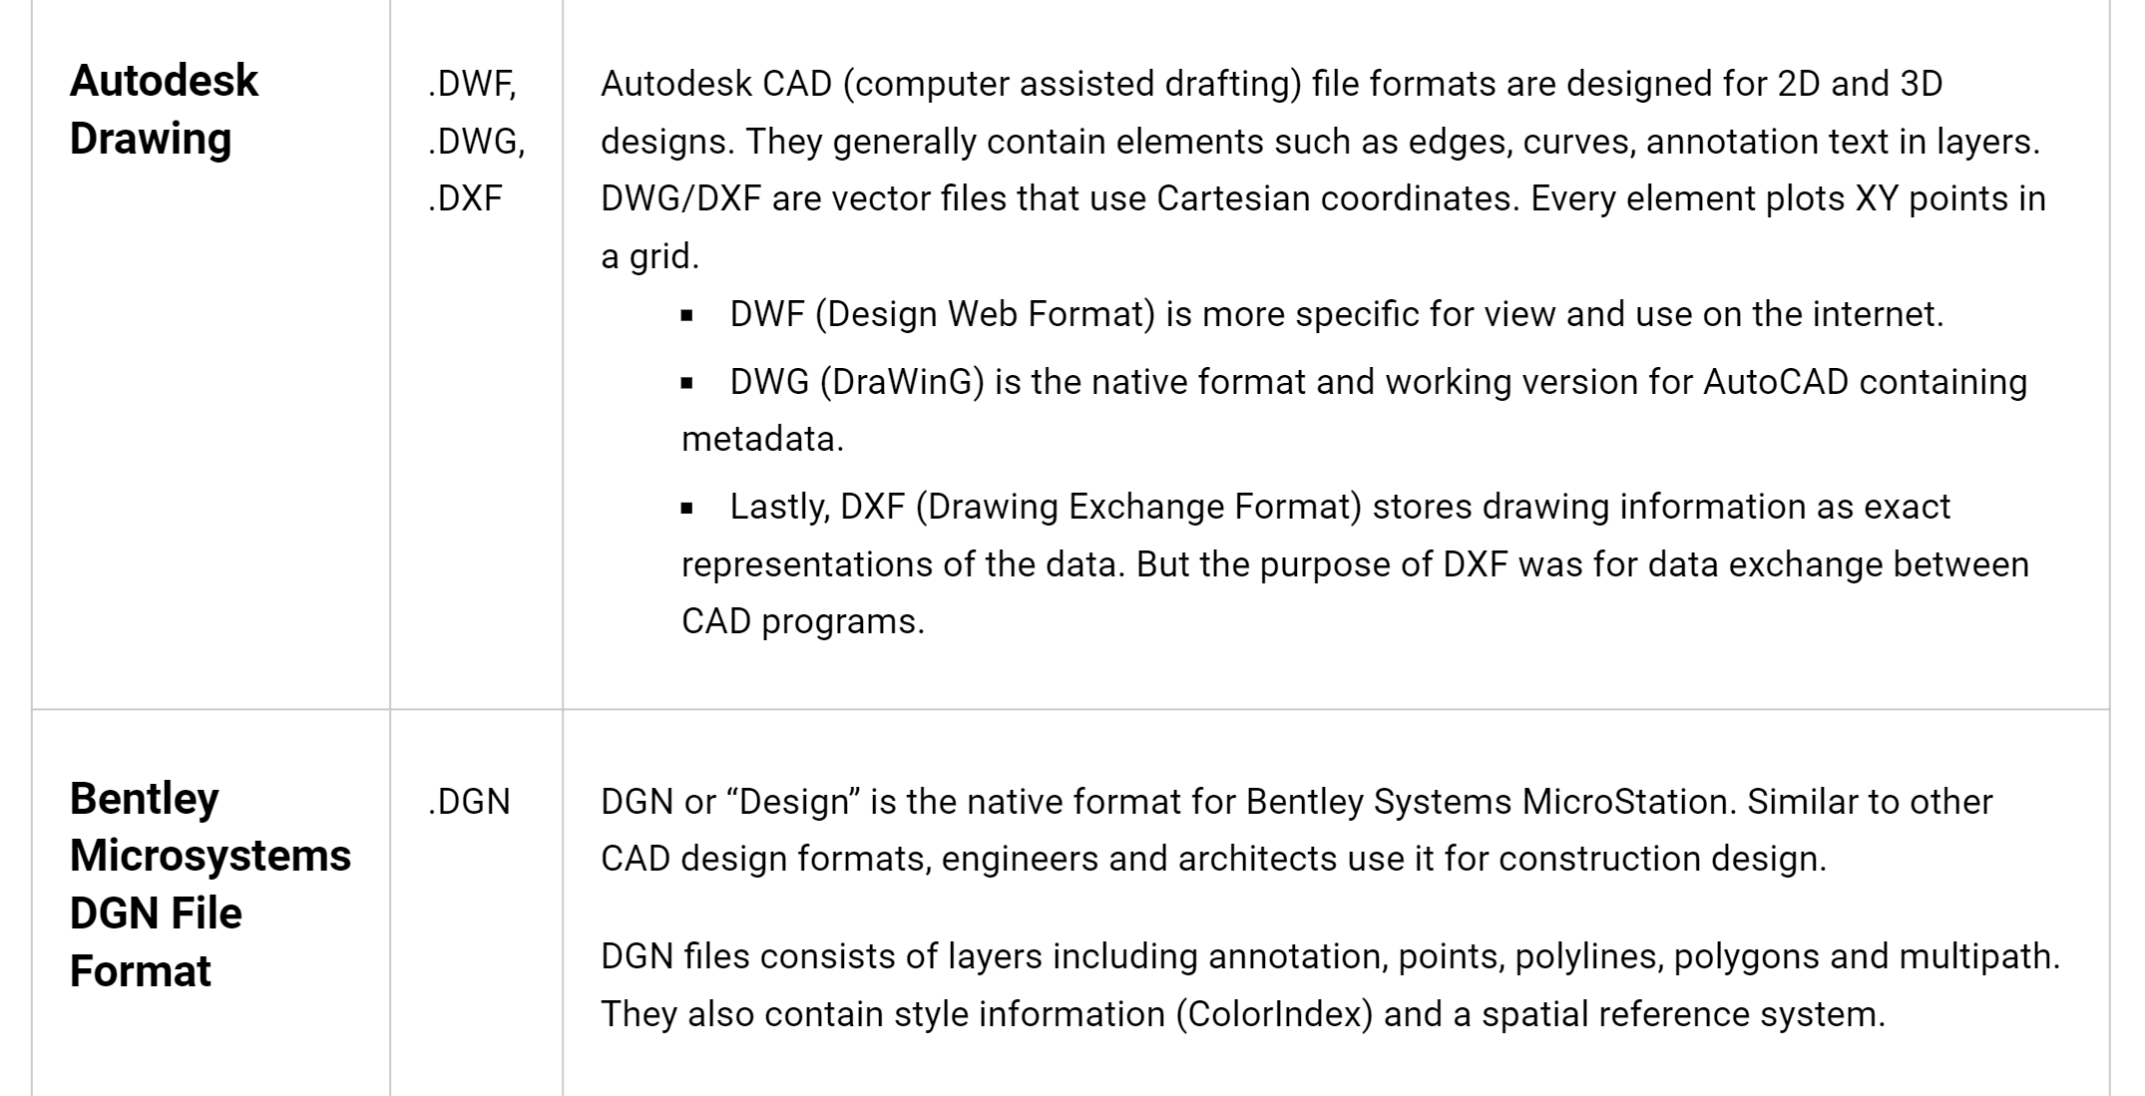
CAD File Formats
CAD (computer assisted drafting) often goes hand-in-hand with Geographic Information System (GIS). GIS imports design models that were likely built in Autodesk or Bentley Systems MicroStation.

Slide 23
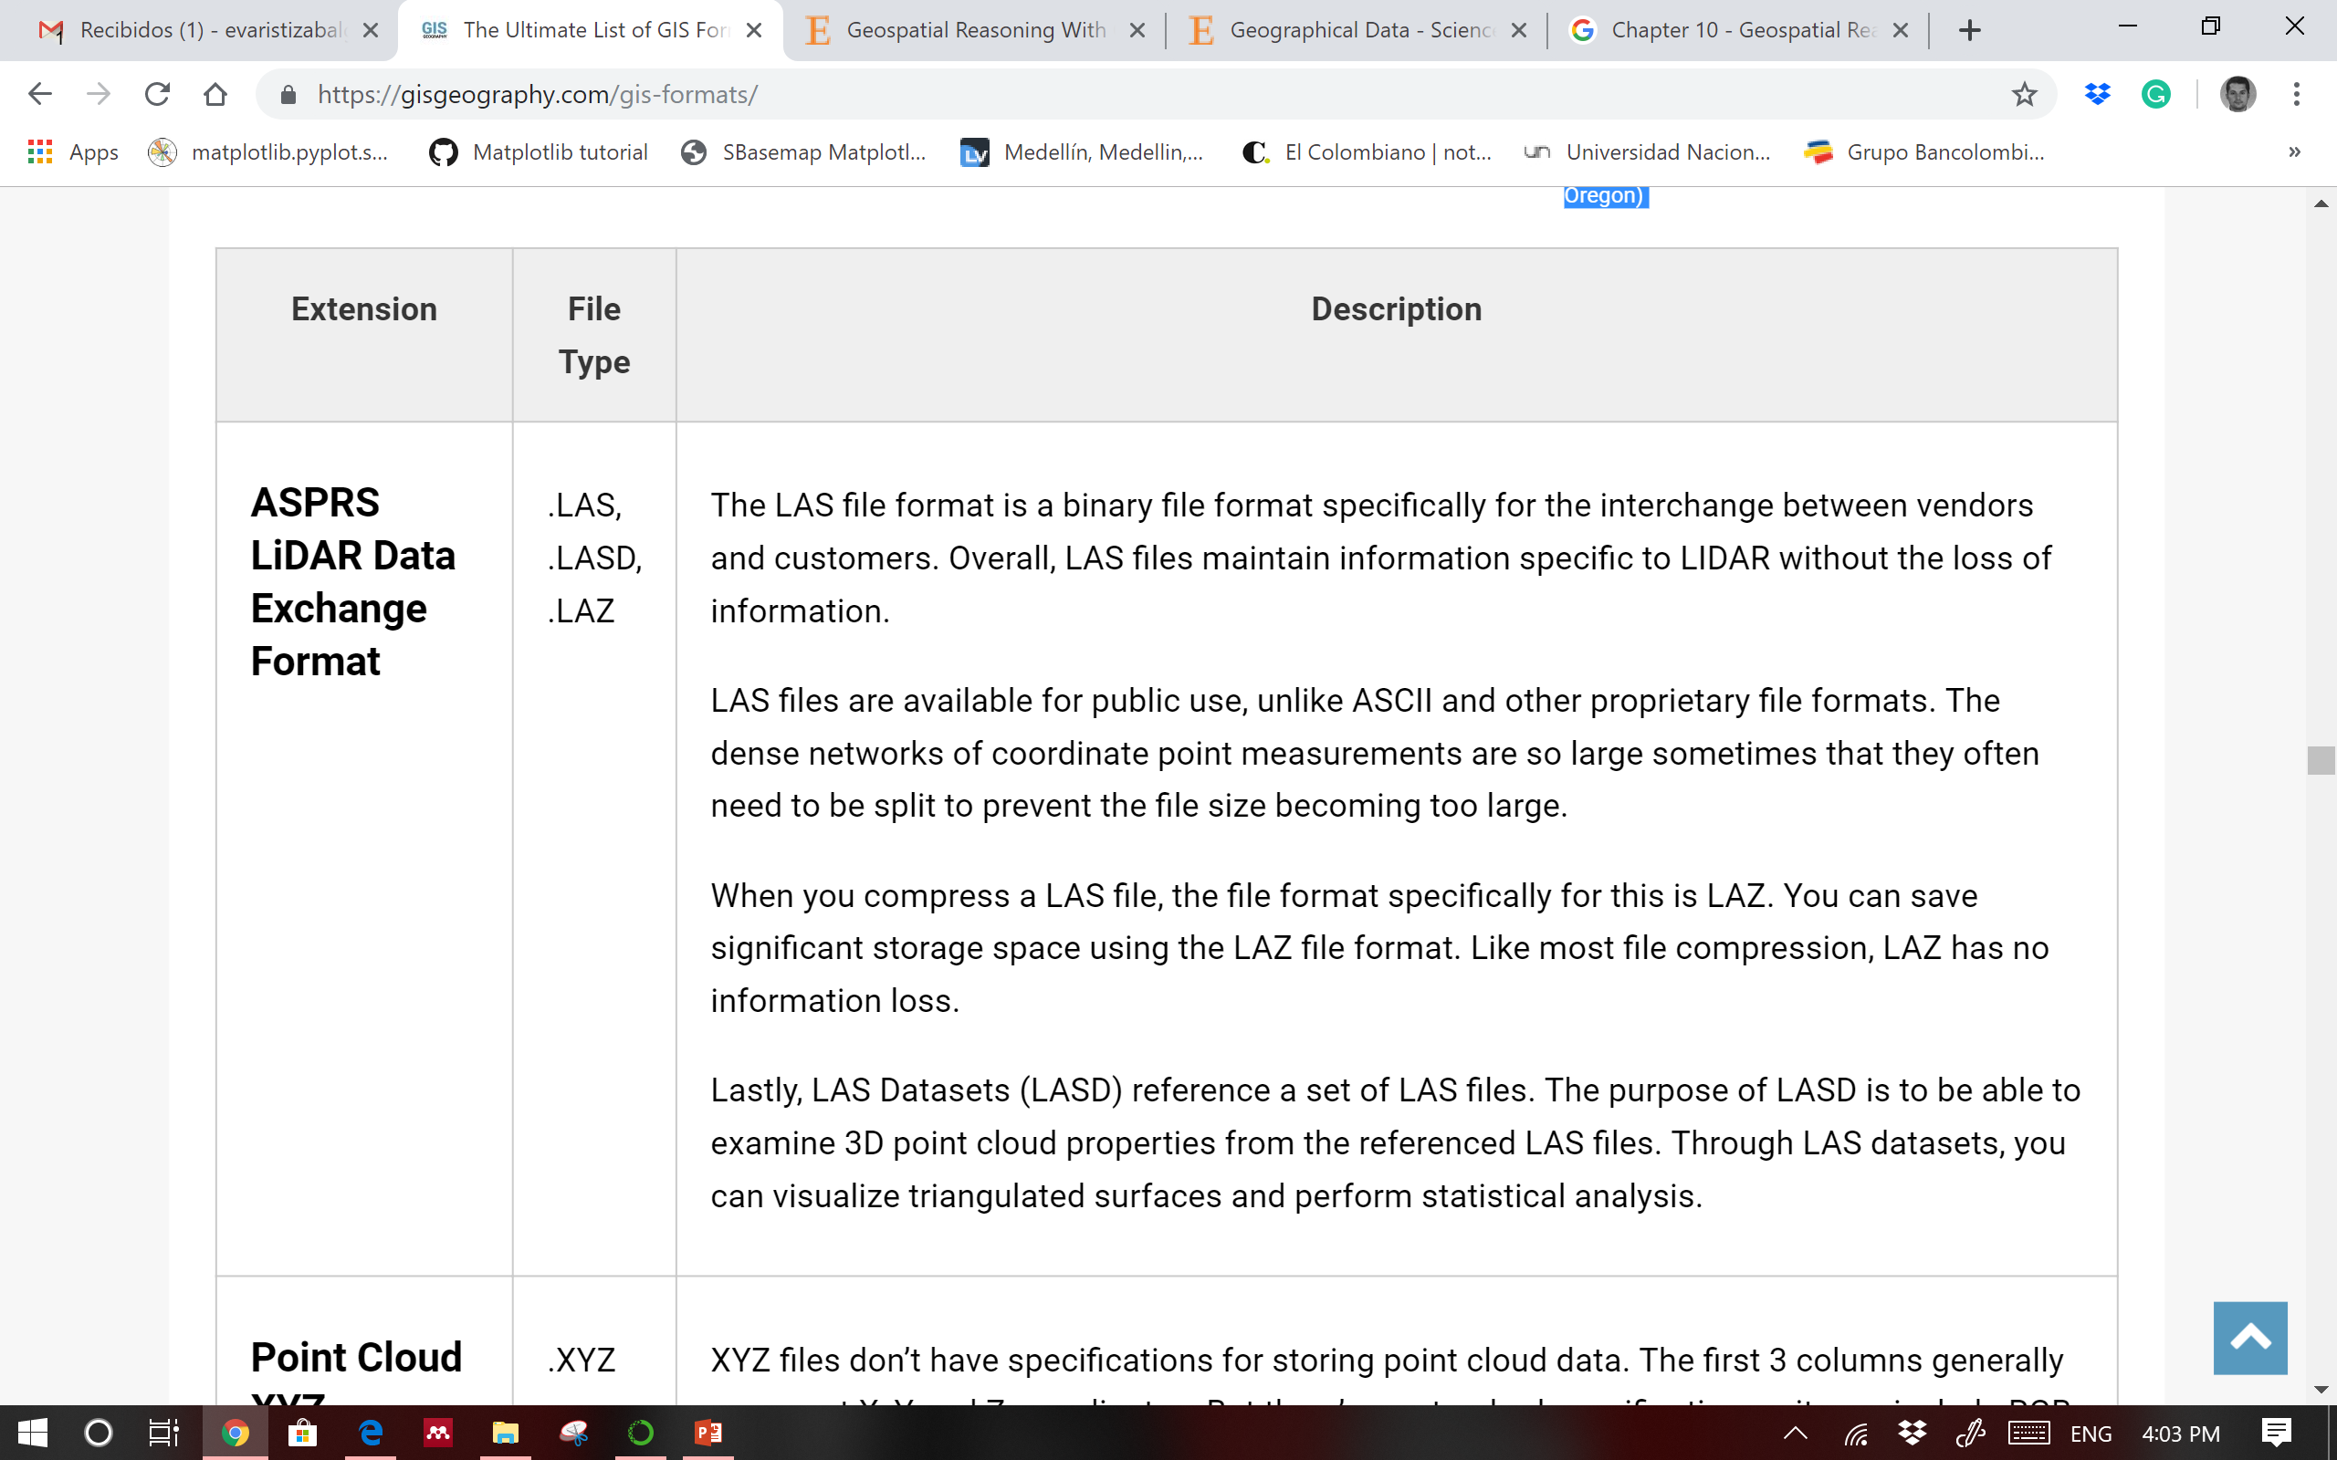
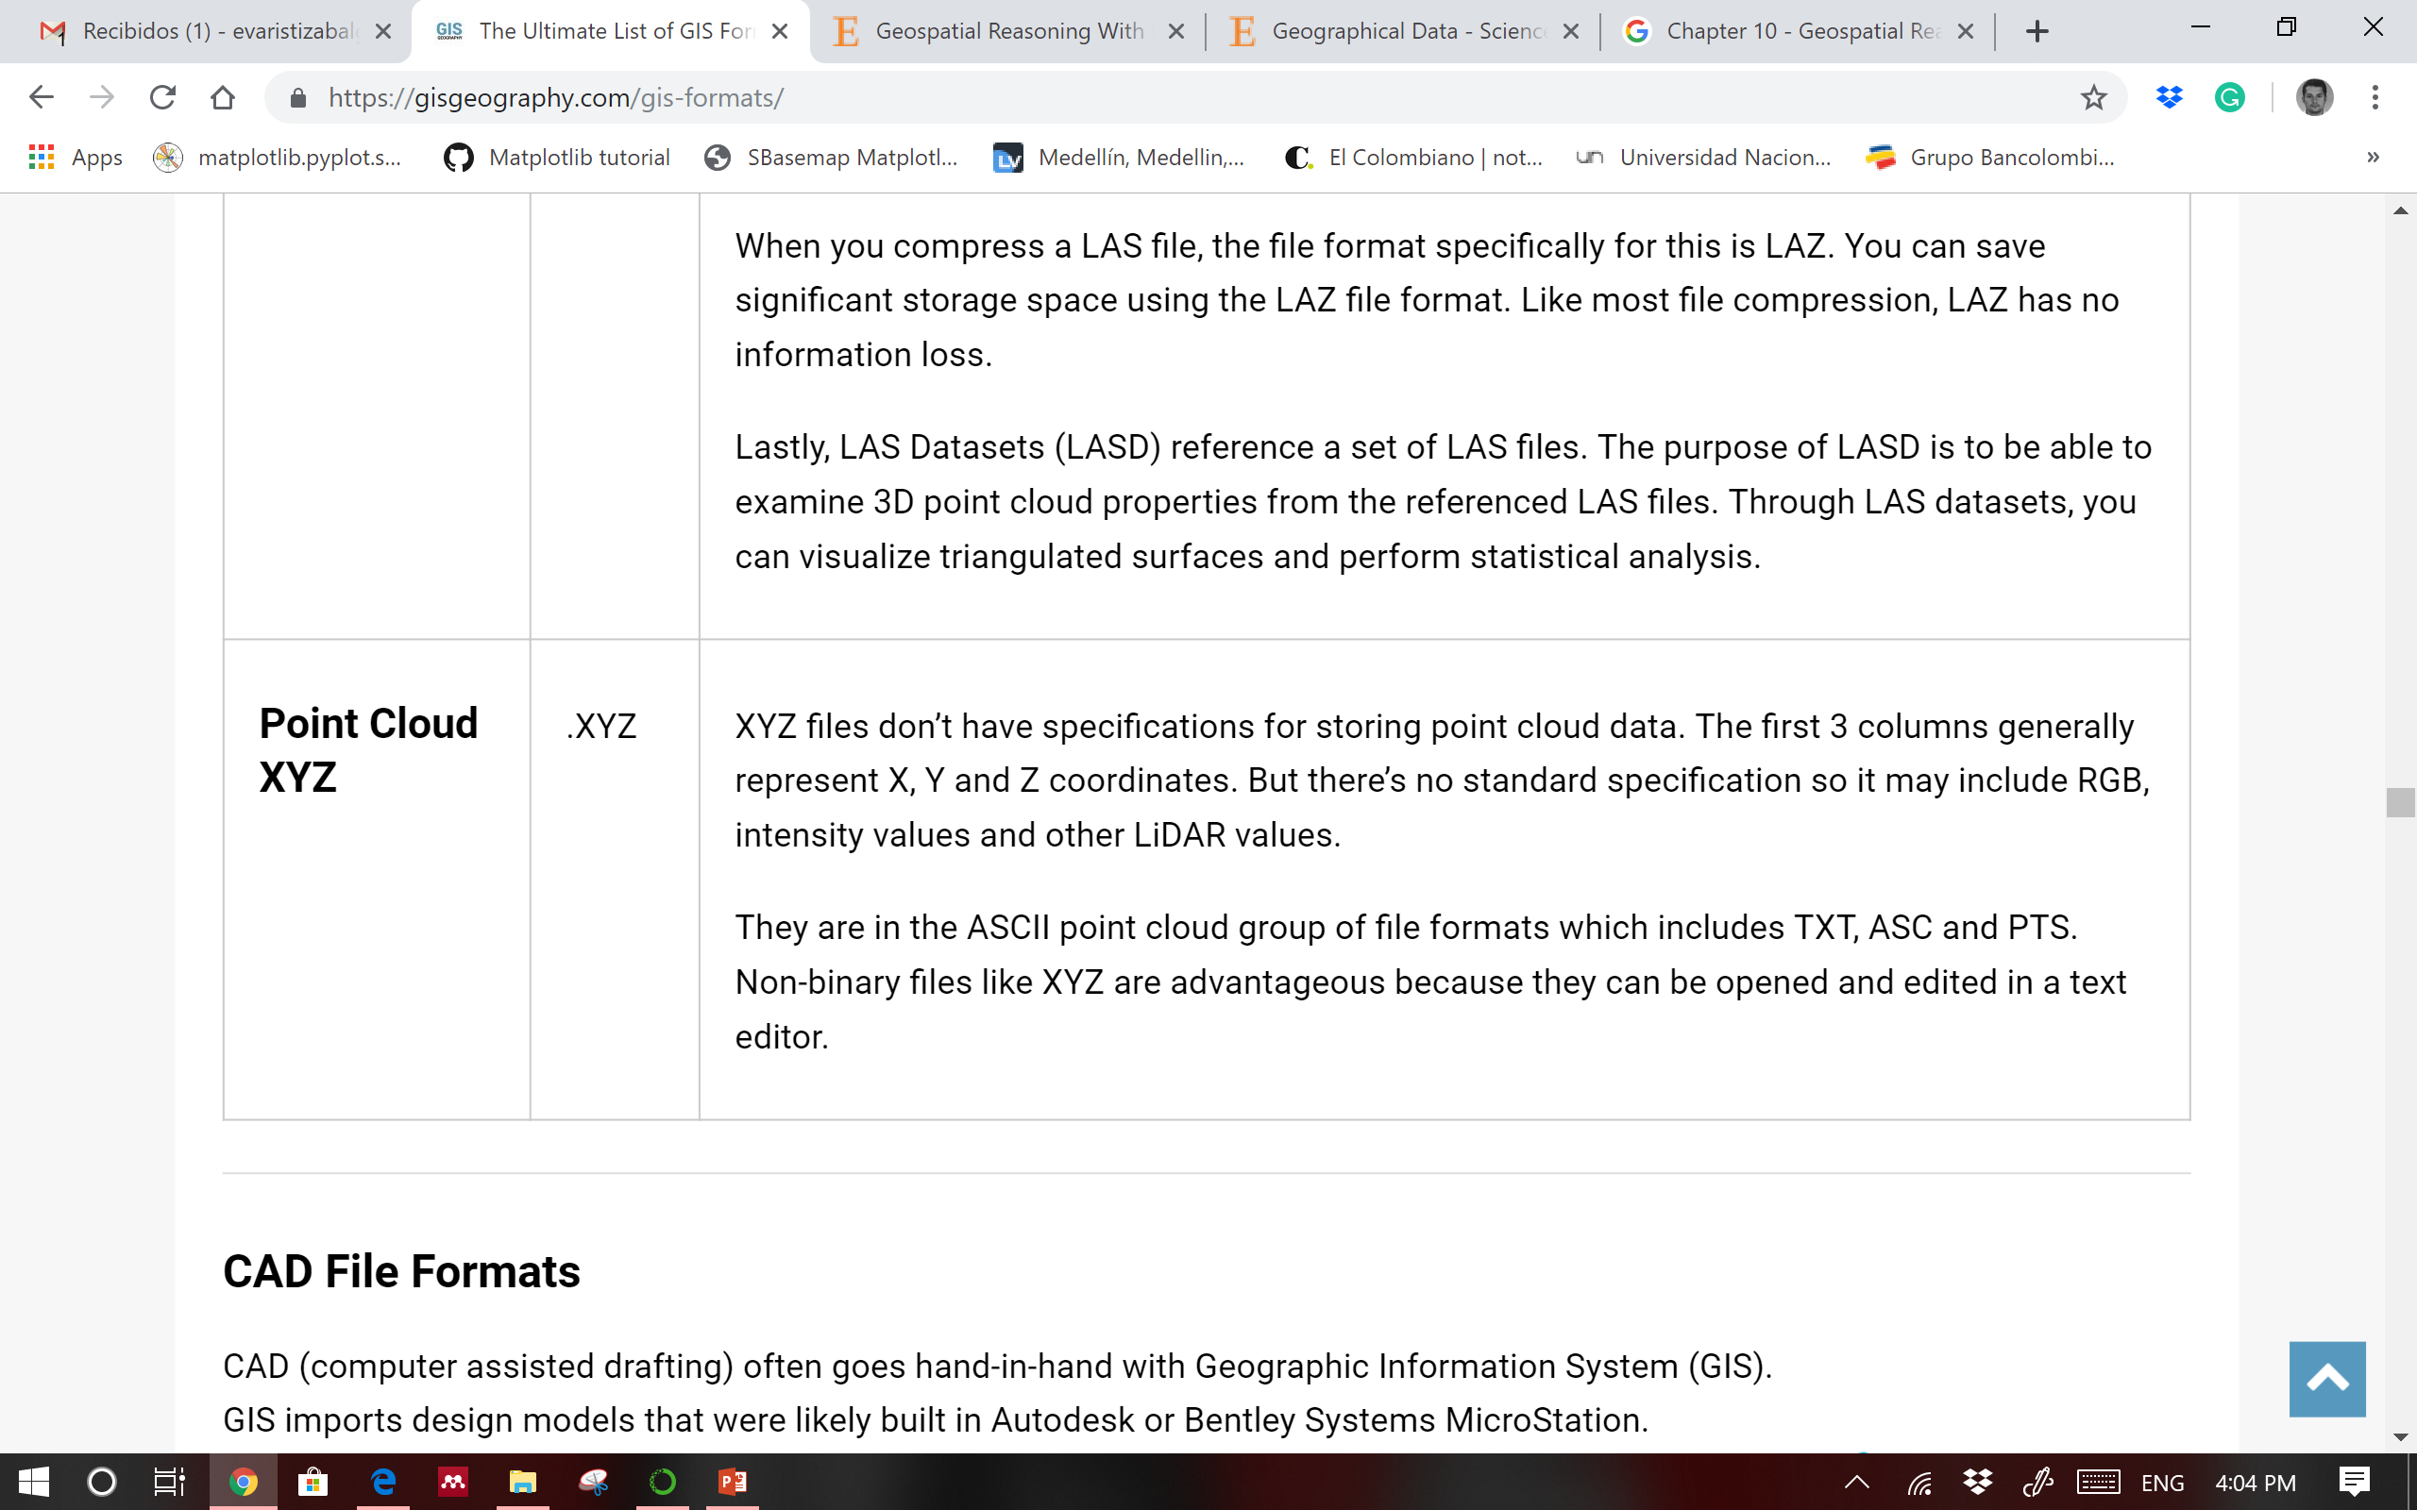
LiDAR File Formats

Slide 24
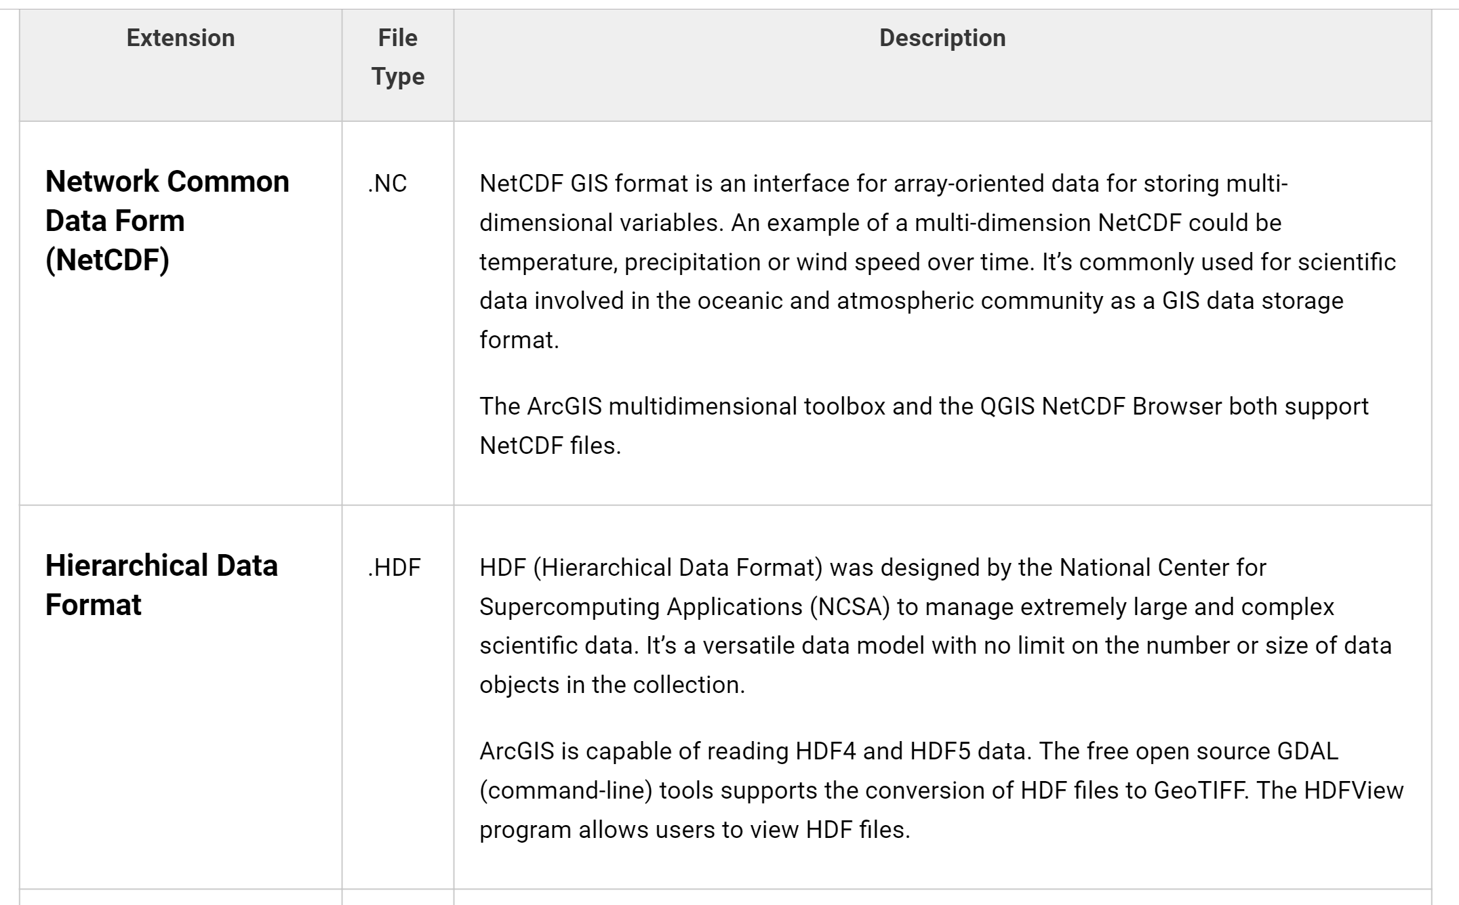
Multitemporal File Formats
Temporal data has a time component attached to it. A lot of weather data uses temporal GIS data formats because how important time is related to weather.

Slide 25
